Slide 1

Same-Day Purchase Speed Analysis

Slide 2
Objectives
Understand the time it takes for users to make their first purchase within the same day after arriving on the site, and identify patterns across device types, acquisition channels, and time of day to analyze user behaviors and optimize conversion flows.

Slide 3
How fast do users purchase after arriving?
Analyze 4793 purchases in 3-month period from November 2020 to January 2021
Typical user buys in 19 minutes.
41% within 15 minutes, 65% within 30 minutes.
Outliers exist ( maximum duration 1415 minutes) and drive the average up (74.71 minutes)

Slide 4
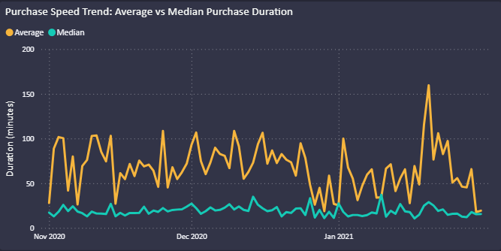
Has purchase speed changed over time?
Typical user behavior is consistent over the period.
Median duration is stable and low
Average fluctuates due to outliers.
Median is the more reliable KPI for product decisions.

Slide 5
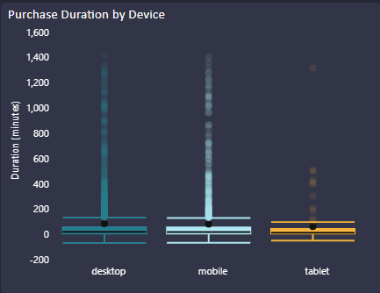
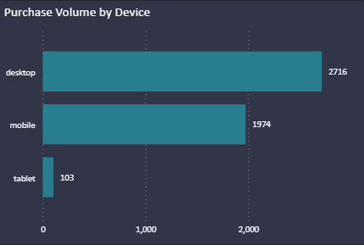
Do purchase speeds differ by device types?
Median duration is similar across devices.
Desktop drives the largest purchase volume but show longer delays and more outliers, optimizing it might bring the highest ROI.
Tablet users has shorter and more consistent purchase durations, but its impact is small because the user base is tiny

Slide 6
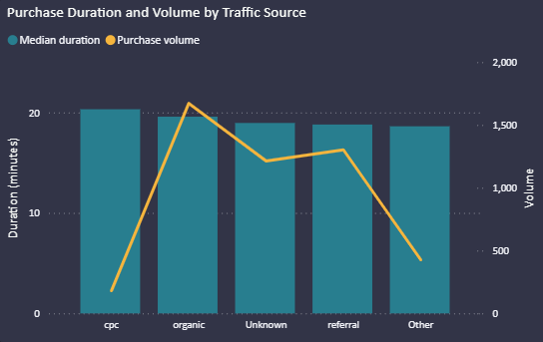
Which medium bring faster or slower buyers?
Organic is the strongest acquisition channel with the highest volume and reasonably fast conversions.
CPC is slowest and low volume, needing optimization and better targeting.

Slide 7
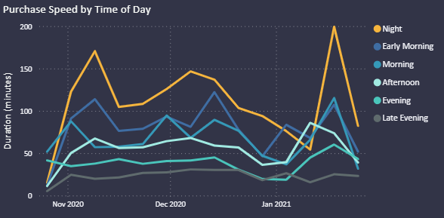
Does time of day impact purchase duration?
Night (00:00–04:00) users take twice as long to purchase, suggesting lower intent at these hours
Explore marketing optimization by time of day

Slide 8
What actions should we take?
Prioritize Desktop optimization by speeding up desktop checkout flow (remove extra steps, add reminders/autofill)
Reassess targeting, landing page of CPC campaigns, and consider relocating budget if results do not improve
Improve tracking setup to reduce “Unknown” category
Prioritize marketing efforts and promotions during daytime slots, consider reminders for night users

Slide 9
What are the limitations of this analysis?
Without details on the type of product or website complexity, it is difficult to judge whether measured purchase durations are unusually long or acceptable.
Only purchases completed on the same calendar day are included. Users who return the next day are excluded.
New buyers and repeat buyers are grouped together, even though they likely have different purchasing behaviors.
There is no revenue weighting, all purchases are treated equally.

Slide 10
What further analysis can be done?
Extend analysis beyond same-day to capture delayed purchases and repeat visits.
Cohort segmentation (new and repeat buyers)
Incorporate order value into metrics
Investigate outliers to check if very long purchase durations are due to site issues, low intent browsing or research customers?
Run A/B tests on desktop checkout improvements

